Slide 1
Working with Cookies

Slide 2
Introduction
Web sites store user information in databases to maintain a track of their visits
Cookies enable Web sites to store user information
PHP supports Hyper Text Transfer Protocol (HTTP) cookies

Slide 3
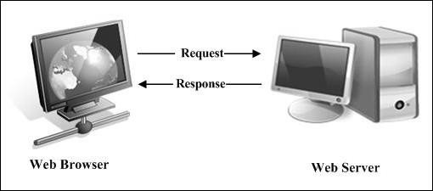
Web Pages
Uses HTTP protocol for sending information to the server
  HTTP is a stateless protocol, because the execution of the current command is completed without the knowledge of commands that came before it
Are of two types:
  Static Web pages
  Dynamic Web pages
Static Web pages
 Web browser requests for a page and the server completes the request by sending the required file
 Does not involve any interaction with the user

Slide 4
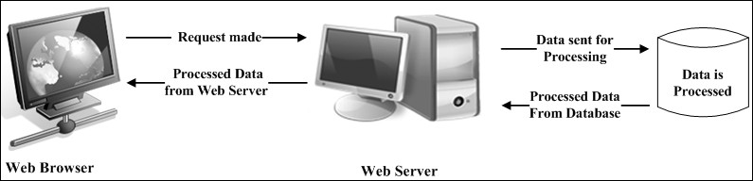
Web Pages
Dynamic Web pages
 Require user interaction, so scripting languages such as
JavaScript, PHP, and ASP are used
 Accept information from the user and record it for further processing

Slide 5
Introducing a Cookie
Data stored by Web sites are as follows:
 Temporary information is stored in cookies for a stipulated period
 Permanent data is stored in cookies for a certain period and then the required information is saved in the database
Types of cookies are as follows:
 Persistent - exist in the Web browser for a period specified at the time of its creation
 Non-persistent - deleted from the Web browser as soon as the user exits the browser

Slide 6
Introducing a Cookie
Web sites use cookies to determine the following:
 Number of times the user has visited the Web site
 Number of new visitors
 Number of regular users
 Frequency of a user visiting the Web site
 Date on which the user had last visited the Web site
 Customized Web page settings for a user

Slide 7
Working of a Cookie
When a user visits the Web site for the first time, the Web server creates a unique ID and sends the ID in the cookie to the Web browser
Browser stores the cookie and sends it back to the Web site in subsequent
requests
Life of a cookie depends on the expiration time and date
Cookie is stored on the hard disk of the user's computer which enables the
Web site to keep a track on the user visiting the Web site
Web servers and Web browsers send cookies to each other in HTTP headers
Web server sends the cookie to the browser in the setcookie header field which is part of the HTTP response
Web browser stores the cookie and uses the same in subsequent requests
to the same Web server

Slide 8
Working of a Cookie
Consider the following HTTP response header:
Snippet
HTTP/2.0 200
Content-Length: 8451 Content-Type: text/html
Date: Mon, 27 Dec 2010 05:29:24 GMT
Expires: Mon, 27 Dec 2010 05:29:44 GMT setcookie: city=east-coast-usa

Slide 9
Working of a Cookie
3-4
In the code, the following information is displayed:
 Version number of the HTTP protocol
 Size of the content
 Type of the content
 Date and time of response
 Expiry date and time of the cookie
 Cookie header

Slide 10
Working of a Cookie
Consider the following HTTP response header:
Snippet
GET /usa/florida.php HTTP/2.0
Connection: Keep-Alive Cookie: city=east-coast-usa Host: www.Webworldmaps.com
Referrer: http://www.Webworldmaps.com/
Cookie can be defined using the setcookie
function.
Code displays a subsequent request that the Web browser sends to the Web server.

Slide 11
Setting a Cookie
Setting a cookie is sending the cookie to the browser
PHP uses two functions, setcookie()and setrawcookie()to set a cookie
setrawcookie()function sends a cookie without encoding the cookie value
setcookie()function generates the cookie header field that is sent along with the rest of the header information

Slide 12
Setting a Cookie
The setcookie()function is as follows:
Syntax
setcookie(name, value, expiry date, path, domain, secure)
Where,
name - defines the name of the cookie
value - defines the value of the cookie that is stored on the client system
expiry date - defines the date and time (UNIX timestamp) when the cookie will expire
path - defines the location on the server where the cookie will be stored.
domain - defines the domain name where the cookie is made available
secure - defines the type of HTTP connection that the cookies will pass through

Slide 13
Setting a Cookie
When the cookie is set, the value is automatically encoded in the URL
When the script retrieves a cookie, it automatically decodes the value from
the URL
Cookies are a part of the HTTP header and there can be more than one cookie in the header, but it should relate to the same domain or Web site
The code related to the cookies must be specified before the following:
 HTTP header
 Displaying any content
 Any white space
 If any content is displayed before calling the setcookie()function, the function will fail and return False
 If the setcookie()function runs successfully, the function returns True

Slide 14
Setting a Cookie
Setting a cookie that expires in one day in a Web site that displays country maps when a user enters a country name in the search feature of the Web site are as follows:
Snippet
$mapname = $_GET['fmapname'];
setcookie("mycookie", $mapname, time()+86400,
"/Webmap/", ".Webworldmaps.com");

Slide 15
Setting a Cookie
In the code, fmapname is the variable that contains the country name that the user enters
The $mapname variable stores the value that the GET method retrieves from the form
The setcookie()function includes the following:
 mycookie - defines the name of the cookie
 time()+86400 - specifies the time when the cookie will expire
 /Webmap - defines the location where the cookie will be stored
 .Webworldmaps.com - specifies the domain that the cookie will use

Slide 16
Setting a Cookie
Creating a cookie that expires when the Web browser window is closed are as follows:
Snippet
$val = $_GET['uname'];
setcookie("uname",$val);
In code, uname is the variable that contains a value. The $val variable stores the value of uname that the GET method retrieves.
The setcookie()function in the code snippet sets a cookie named uname.
The value of $val is assigned to the cookie, uname.

Slide 17
Retrieving Cookies in PHP
Cookies are useful only when the Web server can retrieve the information from it
The Web browser matches the URL against a list of all the cookies present on the client system
If the Web browser finds a match, a line containing the name value pairs of the matched cookie is included in the HTTP header
Document that created the cookie as well as that are present in the same directory can access it
Documents outside the directory need to include the path or the domain name of the cookie to access the cookie

Slide 18
Retrieving Cookies in PHP
PHP provides three ways of retrieving a cookie value and they are as follows:
 Passing a variable as the cookie name - retrieve the cookie value, use the variable as the cookie name. The following code snippet displays a cookie value:
Snippet
echo $cookie_name;
 This method of retrieving the cookie value is not recommended as PHP will start searching all the variables present in the client system
 The register_globals option must be enabled in the configuration file

Slide 19
Retrieving Cookies in PHP
 Using $_COOKIE array
 PHP uses cookie name as a variable to retrieve the cookie value.
PHP can also use an associative array called $_COOKIE to
retrieve the cookie value
 The $_COOKIE is a global variable that reads a value of the cookie
 An example of this is shown as follows:
Snippet
echo $_COOKIE [$cookie_name];
 This is more reliable and faster than retrieving the cookie value through a variable

Slide 20
Retrieving Cookies in PHP
Snippet
<?php
$cookieval = $_COOKIE ['uname']; ?>
<HTML>
<BODY>
<?php
if (isset($cookieval))
{
echo "Welcome $cookieval";
}

Slide 21
Retrieving Cookies in PHP
retrieve_cookie.php - Retrieving a cookie value using
the $_COOKIE global variable
Snippet
else
{
echo "You need to log in";
}
?>
</BODY>
</HTML>

Slide 22
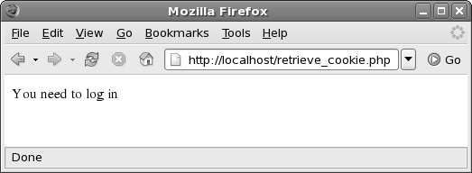
Retrieving Cookies in PHP
The output of the script is as follows:
$cookieval stores the cookie value.
The isset()function checks whether the cookie is set

Slide 23
Deleting a Cookie
Cookies can be deleted automatically or manually
There are two ways to delete a cookie, which are as follows:
 Resetting the expiry time of the cookie to a time in the past
 Resetting a cookie by specifying the name of the cookie
When you create a cookie that has the same name and time as an existing
cookie, the existing cookie is deleted from the hard drive of the client
To delete a cookie with a date in the past, enter the code as shown in the Snippet in a PHP script
Snippet
setcookie("$cookie_name", "", time()-8000);
In the code, $cookie_name refers to the name of the cookie. The value of the cookie is not specified and the time()function accepts the expiration date in the past

Slide 24
Deleting a Cookie
This process is called as deconstructing the variable
Use the following syntax to delete a cookie through deconstruction:
Snippet
setcookie($cookie_name);
To delete the cookie named uname
Snippet
setcookie($uname);

Slide 25
Problems with Cookies
Web sites store user-related information on the client system
Cookies are not secure and reliable because the user-related information can be accessed by anyone who has full access to the client system
Following are some of the drawbacks of cookies:
 Cookies cannot contain more than a certain amount of information
 Only a maximum of 29 cookies of a domain can be maintained
 A browser can maintain maximum of 300 cookies
 Storing large number of cookie files slows down the system
 Some users disable cookies while accessing Web sites as a result Web sites that depend on cookies lose information of such users

Slide 26
Problems with Cookies
 There can be multiple users using the same system visiting the same Web site
 Web sites assign cookies to the system and not to the user. This can
hamper the number of visitor's statistics
 A cookie can contain large amount of information and retrieving larger amount of information on each page requires repetitive coding across the pages

Slide 27
Summary
Web sites use cookies, stored on the hard disk of the client system, to store user-specific information
Dynamic Web pages gets information from the user and records it for further processing
Persistent cookies are stored in the Web browser for a period specified during the time of its creation and non-persistent cookies are deleted from the Web browser as soon as the user exits the browser
The HTTP header, transmitted between the Web server and the
Web browser, contains cookies
A cookie can be retrieved by passing a variable as a cookie name and using the $_COOKIE[] variable

Slide 28
Summary
PHP uses the setcookie() and setrawcookie() functions to set a cookie
The two ways to delete a cookie are resetting the expiry time of the cookie to a time in the past and by resetting the cookie by specifying the name of the cookie
The maximum number of cookies that can be maintained for a
domain is 20. A browser can maintain maximum of 300 cookies

